Slide 1
Presidency University
[University Logo]
PSAIAC | AIR
Computer Organization and Architecture
CSS2257
RISC & CISC, Addressing Modes, Condition Codes, RISC Instruction Sets, Execution & Branching
Faculty: D. Venkatesan
Semester: I | A.Y. 2026-27
Notes:
Welcome the class warmly and introduce yourself. Say something like: Good morning everyone, I am D. Venkatesan, and today we begin an exciting journey into how computers actually think and execute instructions at the hardware level. Mention the course code and subject clearly so students note it down. Explain that this single lecture will cover five connected building blocks: RISC vs CISC philosophies, addressing modes, condition codes, RISC instruction sets, and how the processor executes and branches through instructions. Reassure them this is foundational and builds gradually, with no assumed prior background. Keep energy high and pace brisk since this is the opening slide.

Slide 2
Today's Roadmap
1
RISC vs CISC: two philosophies of processor design
≡
2
Addressing modes: how instructions locate their data
Condition codes: the processor's status flags
Visual Suggestion
3
Icon: roadmap/milestone icon. Image: a simple 5-step horizontal timeline graphic spanning the five modules.
4
RISC instruction sets, execution, and straight-line sequencing
5
Branching: how programs make decisions
Animation: wipe each roadmap step in left to right.
Presidency University | AIR | CSS2257 | Computer Organization and Architecture
2
Notes:
Give students a bird's-eye view before diving in, so they always know where we are in the lecture. Say: think of today as five connected Lego blocks, each one snapping onto the next. We start with two design philosophies, then move to how instructions find their data, how the CPU remembers results, how RISC organizes work, and finally how programs make decisions. Tell them not to worry about memorizing terms yet; we will build every idea from first principles with examples. Mention that a quiz at the end will reinforce everything, so active participation now pays off later.

Slide 3
Learning Objectives
1
Differentiate RISC and CISC design philosophies with real examples
✓
2
Identify and apply common addressing modes to compute effective addresses
Explain the role of condition code flags (Z, C, N, V) after an operation
Visual Suggestion
3
Icon: checklist/target icon. Image: a simple checklist graphic with five checkmarks.
4
Trace straight-line instruction execution using the Program Counter
5
Explain how conditional and unconditional branching alters program flow
Animation: appear each objective on click.
Presidency University | AIR | CSS2257 | Computer Organization and Architecture
3
Notes:
Read each objective aloud in plain language, not just as a checklist. For example, for the addressing modes objective, say: by the end of today, when you see something like MOV R1, 4(R2), you will be able to say exactly which memory location that instruction touches. Emphasize that these are the same objectives you will be tested against in quizzes and exams, so this slide is essentially a preview of success criteria. Encourage students to revisit this slide mentally at the end of the lecture to self-check their understanding.

Slide 4
Icebreaker: Let's Warm Up!
1
When you hear 'processor' or 'CPU', what comes to mind first?
?
2
Have you ever noticed your phone or laptop feels 'faster' after an update? Why might that be?
If you had to design a robot's brain from scratch, would you make it know a few simple tricks very well, or many complex tricks?
Visual Suggestion
3
Icon: speech-bubble/lightbulb icon. Image: a friendly cartoon of a CPU chip with a thought bubble.
4
Show of hands: who has heard the term 'RISC' or 'ARM chip' before, maybe from a phone advertisement?
Animation: fade-in questions one by one; pause on each.
Presidency University | AIR | CSS2257 | Computer Organization and Architecture
4
Notes:
Run this as a light, low-stakes activity, not a test. Ask students to just raise hands or shout quick one-word answers; do not call on anyone by name yet, since it is early in the course. For question 3, use their answers to segue directly into the RISC-versus-CISC discussion: say, 'That robot-brain question is exactly the design debate real computer architects had in the 1980s.' Spend no more than 3 to 5 minutes here. Keep the tone playful and encouraging so freshers feel safe participating on day one.

Slide 5
Why This Topic Matters
1
Every app, game, and AI model ultimately runs as machine instructions on a processor
★
2
Your smartphone (ARM, RISC-based) and your laptop (x86, CISC-based) use different design philosophies
Understanding addressing modes and branching explains why some code runs faster than other code
Visual Suggestion
3
Icon: rocket or gear icon. Image: photo collage of a smartphone chip and a laptop chip side by side.
4
This foundation prepares you for compilers, operating systems, and embedded systems courses ahead
Animation: zoom-in on the chip image after bullets appear.
Presidency University | AIR | CSS2257 | Computer Organization and Architecture
5
Notes:
Motivate the topic by connecting it to devices they use every day. Say something like: right now, the phone in your pocket is running on a completely different instruction philosophy than the laptop you might code on. Explain that once they understand these building blocks, concepts in later courses like compilers and operating systems will make far more sense because those courses assume this knowledge. Use a relatable analogy: learning assembly-level concepts is like learning grammar before writing essays; today we learn the grammar of how computers 'speak' instructions.

Slide 6
What is an Instruction Set Architecture (ISA)?
1
ISA is the contract between hardware and software: the set of instructions a processor understands
⌘
2
It defines the instruction formats, addressing modes, registers, and data types available
Software (compilers, operating systems) is written to target a specific ISA
Visual Suggestion
3
Icon: contract/handshake icon. Image: simple diagram showing 'Software' box connected to 'Hardware' box via an 'ISA' label in between.
4
Two major ISA philosophies exist: CISC (Complex Instruction Set Computer) and RISC (Reduced Instruction Set Computer)
Animation: draw the connecting arrow between Software and Hardware boxes.
Presidency University | AIR | CSS2257 | Computer Organization and Architecture
6
Notes:
Introduce the ISA as the single most important vocabulary term of the lecture, since everything else builds on it. Use the analogy of a restaurant menu: the ISA is like a menu that lists exactly what dishes (instructions) the kitchen (processor) can prepare, and the waiter (compiler) can only order from that menu. Clarify that the ISA is an abstract specification, while the actual electronic circuitry that implements it is called the microarchitecture, so two chips can share the same ISA but be built differently inside. This distinction sets up the RISC vs CISC discussion perfectly.

Slide 7
CISC: Complex Instruction Set Computer
1
Philosophy: provide many powerful, specialized instructions, each doing more work per instruction
C
2
Single instructions can perform multi-step operations (e.g., load from memory, add, and store back)
Variable-length instruction formats and many addressing modes
Visual Suggestion
3
Icon: toolbox with many tools icon. Image: diagram of one long CISC instruction expanding into multiple micro-operations internally.
4
Goal: reduce the number of instructions per program, even if each instruction is complex
5
Examples: Intel x86, x86-64 processors
Animation: wipe reveal of the 'many tools' toolbox icon.
Presidency University | AIR | CSS2257 | Computer Organization and Architecture
7
Notes:
Explain CISC using the toolbox analogy: imagine a Swiss army knife with twenty specialized blades, one for every possible job. Walk through the classic CISC example instruction that can read from memory, add two numbers, and write the result back to memory, all in one instruction. Point out that this reduces the number of lines of assembly code a programmer writes, which was historically valuable when memory was expensive and compilers were primitive. Mention Intel's x86 family as the everyday example students' laptops likely use. Note the trade-off up front, that complexity in the instruction often means complexity, and therefore slowness, in the hardware that decodes it -- this teases the RISC slide next.

Slide 8
RISC: Reduced Instruction Set Computer
1
Philosophy: provide a small set of simple instructions, each executing in about one clock cycle
R
2
Fixed-length instruction format simplifies decoding hardware
Load/Store architecture: only LOAD and STORE instructions touch memory; all other operations use registers
Visual Suggestion
3
Icon: single sharp screwdriver icon (one tool, done well). Image: diagram showing register-to-register operations with memory accessed only via LOAD/STORE arrows.
4
Goal: simpler hardware enables higher clock speeds and efficient pipelining
5
Examples: ARM (smartphones), RISC-V, older MIPS processors
Animation: highlight the LOAD and STORE arrows in the diagram.
Presidency University | AIR | CSS2257 | Computer Organization and Architecture
8
Notes:
Contrast immediately with the CISC slide using the 'one sharp tool used repeatedly' analogy. Emphasize the Load/Store rule clearly, since this is the single most testable RISC fact: arithmetic and logic instructions never touch memory directly, they only operate on registers, and only LOAD and STORE instructions move data between memory and registers. Explain that fixed-length instructions make the decode hardware much simpler, similar to reading fixed-size index cards versus reading paragraphs of varying length. Tell students that ARM, which powers almost every smartphone in the room, is a RISC design, connecting back to the icebreaker discussion.

Slide 9
RISC vs CISC: Side by Side
CISC
RISC
• Many, complex instructions
• Few, simple instructions
• Variable instruction length
• Fixed instruction length
• Instructions can access memory directly
• Only LOAD/STORE touch memory
• Fewer instructions per program, more cycles per instruction
• More instructions per program, ~1 cycle per instruction
• More addressing modes
• Fewer addressing modes
• Example: Intel x86 / x86-64
• Example: ARM, RISC-V
Presidency University | AIR | CSS2257 | Computer Organization and Architecture
9
Notes:
Use this slide as the consolidation moment: walk down each row and ask students to predict the RISC answer before revealing it, if time allows. Stress the cycles-per-instruction trade-off: CISC does more per instruction but each instruction can take multiple cycles, while RISC does less per instruction but each one is fast and pipelines beautifully. If a student asks 'which is better', explain there is no universally better; CISC historically won on code density, RISC wins on hardware simplicity and power efficiency, which is exactly why RISC dominates mobile devices where battery life matters.

Slide 10
Real-World Examples in Your Pocket
1
Your smartphone processor (Snapdragon, Apple A/M-series, MediaTek) is built on the ARM RISC architecture
■
2
Your laptop or desktop (Intel Core, AMD Ryzen) is built on the x86 CISC architecture
Apple's move to M-series (ARM/RISC) chips for MacBooks shows the industry push toward RISC efficiency
Visual Suggestion
3
Icon: smartphone and laptop icons side by side. Image: real photos or logos of ARM-based phone chip vs x86-based laptop chip.
4
Modern CISC chips internally translate complex instructions into simpler RISC-like micro-ops for speed
Animation: fade-in each device icon with its architecture label.
Presidency University | AIR | CSS2257 | Computer Organization and Architecture
10
Notes:
Ground the theory in devices sitting in students' pockets right now. Ask them to check their phone's specs mentally, most will have an ARM-based chip. Highlight the interesting modern twist: even CISC chips like Intel processors internally break complex instructions into simpler RISC-like micro-operations before execution, showing that the two philosophies have converged somewhat over decades. Mention Apple's transition from Intel (CISC) to its own M-series (RISC) chips as a recent, well-publicized real-world example students may have read about, since it directly ties classroom theory to current industry decisions.

Slide 11
Addressing Modes: Why We Need Them
1
An addressing mode defines HOW an instruction specifies the location of its operand (data)
→
2
Operands can be a constant, a register, or a memory location computed in different ways
Addressing modes give flexibility: constants, arrays, pointers, and loops all need different access patterns
Visual Suggestion
3
Icon: map-pin/GPS icon. Image: diagram of a CPU instruction pointing via an arrow to different possible operand locations (register, memory, constant).
4
The instruction's addressing mode directly affects the 'effective address' used to fetch data
Animation: arrow travels from instruction box to each operand location in turn.
Presidency University | AIR | CSS2257 | Computer Organization and Architecture
11
Notes:
Introduce addressing modes as the answer to the question: 'the instruction says ADD, but add what, and where is it?' Use the analogy of giving someone directions: you could give an exact address (direct), a description like 'the house next to mine' (indirect), or 'the third house on this street' (indexed). Clarify the key term 'effective address', the actual final memory location computed after applying the addressing mode rule. Tell students this concept will directly power the worked example a few slides ahead, so understanding the categories now will make that example click into place.

Slide 12
Immediate & Register Addressing
1
Immediate: the operand is a constant value embedded directly in the instruction (e.g., ADD R1, #5)
#
2
Fastest possible access since no memory or register lookup is needed for the operand itself
Register: the operand is held in a CPU register (e.g., ADD R1, R2)
Visual Suggestion
3
Icon: number-tag icon for immediate, register-box icon for register. Image: simple diagram showing '#5' flowing straight into the ALU vs 'R2' flowing from a register box into the ALU.
4
Register addressing is fast because registers sit inside the CPU, avoiding memory access delay
Animation: highlight the '#5' value pulsing directly into the ALU.
Presidency University | AIR | CSS2257 | Computer Organization and Architecture
12
Notes:
Start with the two simplest and fastest addressing modes so students build confidence early. For immediate addressing, stress that the hash symbol or '#' typically signals a literal constant baked right into the instruction, so there is nothing to 'fetch' beyond the instruction itself. For register addressing, remind students that registers are tiny, extremely fast storage locations inside the CPU, so this is the second-fastest option after immediate. Ask a quick check-your-understanding question: 'In ADD R1, #10, R2 -- which part is immediate and which is register?' and let a student answer.

Slide 13
Direct & Indirect Addressing
1
Direct: the instruction contains the exact memory address of the operand (e.g., ADD R1, [1000])
→○
2
Effective Address = the address given in the instruction itself
Indirect: the instruction contains the address of a location that HOLDS the address of the operand
Visual Suggestion
3
Icon: signpost icon for direct, chained-arrow icon for indirect. Image: two boxes, one showing a single arrow to data (direct), another showing an arrow to a box that then arrows again to data (indirect).
4
Effective Address = Memory[address given in instruction] -- an extra 'lookup' step, like a pointer
Animation: wipe the extra arrow hop for indirect addressing to visualize the pointer chain.
Presidency University | AIR | CSS2257 | Computer Organization and Architecture
13
Notes:
This is often the trickiest pair for freshers, so slow down here. For direct addressing, say: the instruction literally hands you the street address, walk straight there. For indirect addressing, use the pointer analogy: the instruction hands you a piece of paper with an address written on it, but that address itself is not your destination, it is the address of a mailbox that CONTAINS the real address; you must open that mailbox first, then go to the address found inside. Draw this chain on the board if possible: Instruction to Address A to Memory[A] to real operand. Reassure students this exact chain becomes the seed for the worked example coming up.

Slide 14
Indexed & Base-Register Addressing
1
Indexed: Effective Address = Base Address + Index Register value (great for array access)
[i]
2
The index register can increment automatically to 'walk through' array elements in a loop
Base-Register: Effective Address = Base Register value + Offset/Displacement given in instruction
Visual Suggestion
3
Icon: array/grid icon with a moving pointer. Image: a row of array boxes with an index arrow sliding from element 0 to element 3.
4
Base-register addressing is ideal for accessing fields within a data structure or stack frame
Animation: index pointer slides across array boxes left to right.
Presidency University | AIR | CSS2257 | Computer Organization and Architecture
14
Notes:
Connect this directly to something students already know: array indexing in programming, like arr[i] in Python or C. Explain that indexed addressing is the hardware-level version of that exact idea: a base address (where the array starts) plus an index (how many elements to skip). For base-register addressing, use the analogy of a fixed reference point, like a building's ground floor, with an offset telling you which floor to go to; this is exactly how local variables on a stack frame are accessed relative to a base pointer. Mention that compilers automatically generate these addressing modes when you write loops or access structure fields, so this is not just theory, it happens every time they run code.

Slide 15
PC-Relative (Relative) Addressing
1
Effective Address = Program Counter (PC) value + Offset given in the instruction
PC+
2
Used heavily for branch instructions: 'jump forward 8 instructions from here'
Advantage: code can be loaded anywhere in memory and still work correctly (position-independent code)
Visual Suggestion
3
Icon: compass/relative-direction icon. Image: a number line showing the current PC position with a curved arrow jumping forward by an offset to the branch target.
4
This addressing mode becomes essential when we discuss branching later in this lecture
Animation: curved arrow animates from PC position forward to the branch target.
Presidency University | AIR | CSS2257 | Computer Organization and Architecture
15
Notes:
Preview why this addressing mode matters by connecting it forward to the branching section coming later. Explain that instead of saying 'go to exact address 2054', relative addressing says 'go forward 6 instructions from wherever you currently are', measured from the Program Counter. Emphasize the practical benefit: because the jump is relative rather than absolute, the same program can be loaded at different memory locations in different runs and the branch still lands correctly, which is called position-independent code. Tell students to keep this slide in mind, since the branching worked example near the end of the lecture will use exactly this addressing mode.

Slide 16
Worked Example: Computing the Effective Address
1
The Problem
Instruction: LOAD R1, 8(R2) -- Base-register addressing. Given: R2 = 2000 (base address), Offset = 8.
2
Identify Given Data
We are given the base register value (R2 = 2000) and the offset encoded in the instruction (8).
3
Apply the Formula
Effective Address (EA) = Base Register value + Offset = 2000 + 8 = 2008.
4
Fetch Operand
The CPU reads the value stored at Memory location 2008 and loads it into register R1.
5
Interpret Result
R1 now holds whatever data was stored at address 2008 -- for example, if Memory[2008] = 42, then after execution R1 = 42.
Presidency University | AIR | CSS2257 | Computer Organization and Architecture
16
Notes:
Walk through this example slowly and out loud, exactly as if solving it live on the board, because this is the moment addressing-mode theory becomes concrete. First restate the problem so everyone is looking at the same instruction. Then explicitly separate 'what is given' from 'what we must find', a habit worth building early for all future numerical problems in this course. Perform the addition step by step: 2000 plus 8 equals 2008, and narrate that this final number is called the effective address. Finish by interpreting the result in plain English: R1 now contains actual data, not an address, so the offset trick let us reach 8 memory locations past wherever R2 was pointing. Invite a student to redo the same calculation with a different offset value as a live check.

Slide 17
Condition Codes: The Processor's Status Flags
1
Condition codes (flags) are single bits set automatically after arithmetic/logic operations
ZNCV
2
Z (Zero): set to 1 if the result of the operation is exactly zero
N (Negative): set to 1 if the result is negative
Visual Suggestion
3
Icon: traffic-light/status-flag icon. Image: a small status register diagram showing four labeled flag bits: Z, N, C, V.
4
C (Carry): set to 1 if the operation produced a carry-out (useful for unsigned overflow)
5
V (Overflow): set to 1 if the operation caused signed overflow (result doesn't fit correctly)
Animation: each flag bit lights up individually as it's explained.
Presidency University | AIR | CSS2257 | Computer Organization and Architecture
17
Notes:
Introduce condition codes as the CPU's short-term memory about 'what just happened' in the last operation, stored in a tiny special register often called the status register or flags register. Go through each flag with a concrete trigger example: Z flips to 1 after SUB R1, R1, R1 because any number minus itself is zero. N flips to 1 whenever a subtraction produces a negative result. C is about unsigned arithmetic overflowing past the register's capacity, like an odometer rolling past its maximum. V is specifically about signed overflow, like adding two large positive numbers and getting a result that looks negative due to limited bit-width. Tell students these four flags are not optional extras, they are literally what conditional branching reads to make decisions, which sets up the rest of the lecture.

Slide 18
Worked Example: Setting Condition Codes
1
The Problem
Execute: SUB R3, R1, R2 where R1 = 5 and R2 = 5 (8-bit registers). Determine the resulting Z, N, C, V flags.
2
Perform Operation
R3 = R1 - R2 = 5 - 5 = 0. The arithmetic result is exactly zero.
3
Set Zero Flag (Z)
Since the result is 0, Z = 1.
4
Set Negative Flag (N)
The result 0 is not negative, so N = 0.
5
Set Carry & Overflow (C, V)
No borrow occurred and the result fits within range, so C = 0 (no borrow) and V = 0 (no signed overflow).
Presidency University | AIR | CSS2257 | Computer Organization and Architecture
18
Notes:
Use this example to make the abstract flags feel mechanical and predictable, not mysterious. Perform the subtraction first, exactly as the ALU would, and get zero as the raw arithmetic result. Then go flag by flag, asking rhetorically 'is the result zero? yes, so Z becomes 1' and so on, modeling the exact reasoning students should use on an exam. Point out that this specific case, subtracting a register from itself, is actually how many processors implement a 'compare' or even a 'clear register to zero' trick, which is a nice real-world tie-in. Mention that in the next few slides these very flags will be tested by branch instructions to decide whether to jump.

Slide 19
Introduction to RISC Instruction Sets
1
RISC instruction sets follow the Load/Store architecture strictly
□
2
Instruction categories: Data Transfer (LOAD/STORE), Arithmetic/Logic (ADD, SUB, AND, OR), Control (BRANCH, JUMP)
All arithmetic and logic instructions operate only on registers, never directly on memory
Visual Suggestion
3
Icon: three-category folder icon (Transfer, Arithmetic, Control). Image: simple diagram of a register file box connected to an ALU box, with memory only reachable via LOAD/STORE.
4
A large general-purpose register file (commonly 16-32 registers) minimizes slow memory access
Animation: three category folders open one at a time to reveal example instructions.
Presidency University | AIR | CSS2257 | Computer Organization and Architecture
19
Notes:
Return explicitly to the Load/Store rule from the earlier RISC slide, now framing it as an organizing principle for the entire instruction set, not just a fun fact. Introduce the three broad instruction categories students will see repeatedly: data transfer instructions that only move data between memory and registers, arithmetic and logic instructions that only work register-to-register, and control instructions that alter the flow of execution. Explain why RISC designers include a large register file, often sixteen or thirty-two registers, precisely so programs rarely need to touch slow memory. Tell students that every worked example for the rest of the lecture will follow this exact three-category structure.

Slide 20
RISC Instruction Formats & Types
1
Fixed-length instructions (e.g., 32 bits) simplify fetch and decode hardware
▤
2
R-type (Register): operates on register operands only, e.g., ADD R1, R2, R3
I-type (Immediate): includes a constant value, e.g., ADDI R1, R2, #10
Visual Suggestion
3
Icon: fixed-grid/template icon. Image: a labeled bit-field diagram showing Opcode | Rs1 | Rs2 | Rd sections of a 32-bit instruction.
4
Common fields in every instruction: Opcode (operation), Source register(s), Destination register
Animation: highlight each bit-field segment in sequence (Opcode, then registers).
Presidency University | AIR | CSS2257 | Computer Organization and Architecture
20
Notes:
Show students what an instruction actually looks like 'under the hood' as a sequence of bits divided into fields. Explain that because every RISC instruction is the same fixed length, the hardware decoder can always know exactly where the opcode field starts and ends without any guesswork, unlike variable-length CISC instructions. Walk through R-type versus I-type as the two instruction shapes they will use most in later assembly programming labs: R-type when every operand is a register, I-type when one operand is a constant baked into the instruction. Reassure students they do not need to memorize exact bit positions today, just the concept that instructions are structured, fixed-size data.

Slide 21
Instruction Execution: Fetch-Decode-Execute Cycle
1
Fetch
The CPU reads the instruction located at the address currently held in the Program Counter (PC).
2
Decode
Control hardware interprets the opcode and identifies the operands and addressing mode involved.
3
Execute
The ALU or relevant hardware performs the actual operation (e.g., addition, memory load).
4
Write-back
The result is written to the destination register (or memory, for STORE instructions).
5
Update PC
The Program Counter is updated to point to the next instruction, and the cycle repeats.
Presidency University | AIR | CSS2257 | Computer Organization and Architecture
21
Notes:
Present this as the heartbeat of every processor, repeating billions of times per second. Walk through each stage using a simple relatable analogy: fetch is like reading the next line of a recipe, decode is understanding what that line asks you to do, execute is actually doing it, such as measuring flour, and write-back is placing the measured flour into the bowl. Emphasize that updating the Program Counter is what makes this a CYCLE rather than a one-time event, since the CPU immediately loops back to fetch the next instruction. Tell students this five-stage mental model directly explains the next topic, straight-line sequencing, where we watch the PC increment predictably.

Slide 22
Straight-Line Sequencing: The Concept
1
By default, the Program Counter (PC) increments after every instruction fetch
→→
2
This causes instructions to execute in the exact order they are stored in memory
'Straight-line' means no jumps or branches -- pure top-to-bottom, sequential execution
Visual Suggestion
3
Icon: straight-arrow/conveyor-belt icon. Image: a vertical stack of instruction boxes in memory with a downward arrow showing sequential PC progression.
4
If instructions are 4 bytes each, PC increases by 4 after each fetch (e.g., 1000, 1004, 1008...)
Animation: PC marker slides straight down the instruction stack.
Presidency University | AIR | CSS2257 | Computer Organization and Architecture
22
Notes:
Introduce straight-line sequencing as the 'default behavior' of a processor when nothing tells it to do otherwise, directly building on the PC-update stage from the previous slide. Use the analogy of reading a book: without any instruction to 'skip to chapter 5', you naturally read page after page in order. Point out the specific numeric detail that matters for the next worked example: if each instruction occupies exactly 4 bytes in memory, the PC does not increase by 1 each time, it increases by 4, since addresses are counted in bytes, not instructions. This detail often confuses freshers, so pause and confirm understanding with a quick verbal check.

Slide 23
Worked Example: Tracing PC Through Straight-Line Code
1
The Problem
Given: PC starts at 2000. Three 4-byte instructions execute in sequence with no branches. Find the PC value before fetching each instruction.
2
Instruction 1
PC = 2000. Fetch instruction at address 2000. After fetch, PC becomes 2000 + 4 = 2004.
3
Instruction 2
PC = 2004. Fetch instruction at address 2004. After fetch, PC becomes 2004 + 4 = 2008.
4
Instruction 3
PC = 2008. Fetch instruction at address 2008. After fetch, PC becomes 2008 + 4 = 2012.
5
Interpret Result
The PC advances predictably by 4 each step: 2000, 2004, 2008, 2012 -- confirming pure sequential execution.
Presidency University | AIR | CSS2257 | Computer Organization and Architecture
23
Notes:
Treat this like a simple arithmetic drill, but narrate every increment out loud so the pattern becomes obvious. Start by writing PC = 2000 clearly, then physically add 4 for each subsequent line, asking students to predict the next PC value before you reveal it, which turns a passive slide into an active quiz-in-miniature. Once all three values are on the board, step back and ask: 'what pattern do you notice?' expecting the answer that PC always increases by the same fixed amount, 4, matching instruction size. Close by explicitly stating that this predictable pattern is exactly what BREAKS when we introduce branching next, which is the perfect segue into the following section.

Slide 24
Branching: Why We Need It
1
Straight-line sequencing alone cannot express decisions, loops, or repeated logic
↷
2
A branch instruction can load a NEW value into the Program Counter, altering the flow
Branching enables: if-else decisions, for/while loops, and function calls in high-level languages
Visual Suggestion
3
Icon: forked-path/decision-diamond icon. Image: a flowchart showing a diamond decision box splitting into two paths.
4
The branch target address is often computed using PC-relative addressing (recall Slide 15)
Animation: path splits and one branch highlights as 'taken'.
Presidency University | AIR | CSS2257 | Computer Organization and Architecture
24
Notes:
Motivate branching by pointing out a real limitation: everything we traced in the previous straight-line example marches forward predictably, but that alone cannot implement something as simple as an if statement or a for loop, both of which every student has already written in a programming class. Explain that a branch instruction is special precisely because it is allowed to overwrite the Program Counter directly, breaking the predictable plus-4 pattern on purpose. Explicitly connect back to PC-relative addressing from earlier, reminding students that the branch target is usually computed as PC plus an offset, tying two earlier concepts together. Set up the next slide by asking: 'but should every branch always jump? or only sometimes?'

Slide 25
Conditional vs Unconditional Branches
Unconditional Branch
Conditional Branch
• Always jumps to the target address, no exceptions
• Jumps ONLY if a specific condition code flag matches
• Example: JMP LOOP_START (or B target)
• Example: BEQ target (Branch if Equal, checks Z = 1)
• Used for: implementing loops that always repeat, or direct jumps
• Used for: if-else logic, loop exit conditions
• Does not check any condition code flags
• Reads flags set by a prior CMP or arithmetic instruction
Presidency University | AIR | CSS2257 | Computer Organization and Architecture
25
Notes:
Contrast these two branch types clearly since exam questions frequently test the difference. For unconditional branches, emphasize the word 'always': no matter what happened before, execution jumps, useful for things like an infinite loop header or a definite jump to a function. For conditional branches, walk through the classic pattern: a CMP (compare) instruction runs first, silently setting the Z, N, C, V flags exactly as covered earlier, and then a conditional branch like BEQ (branch if equal) checks whether Z equals 1 before deciding to jump. Reinforce that this is precisely why we spent time on condition codes earlier, they are not abstract, they directly drive real decision-making in code.

Slide 26
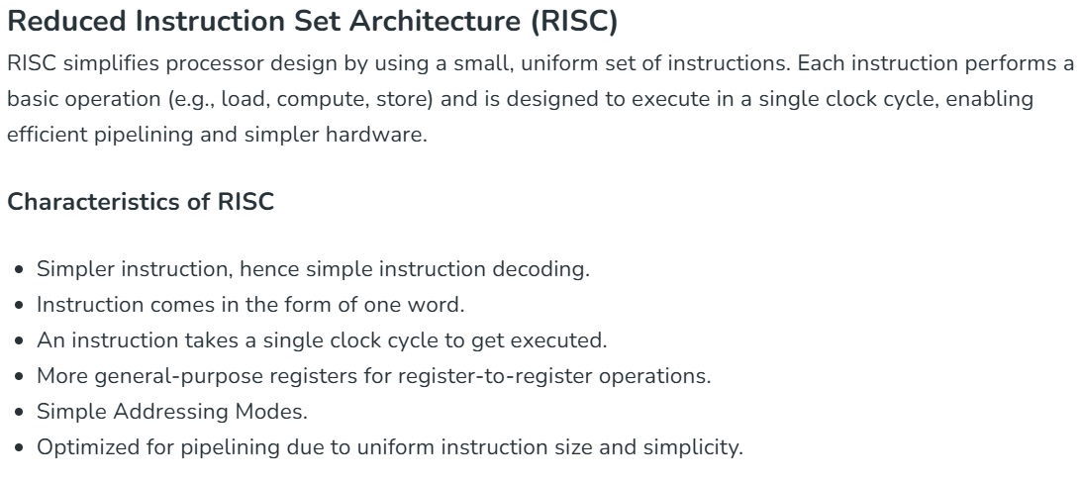

Slide 28
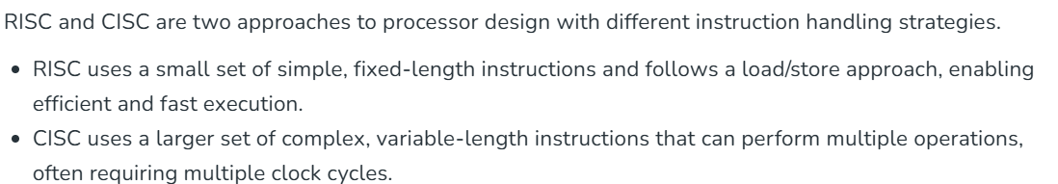
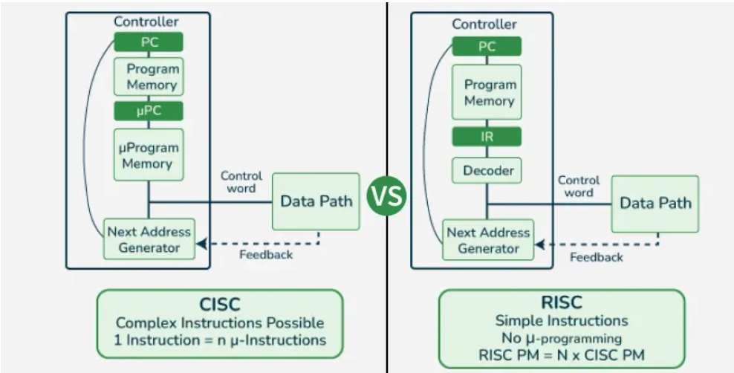

Slide 29
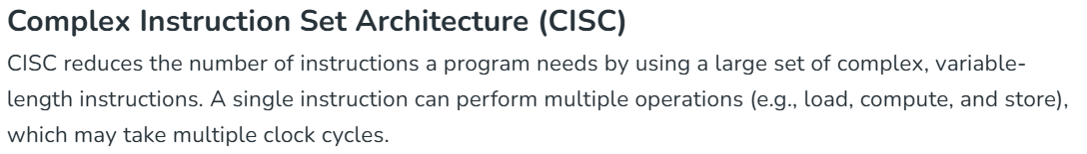
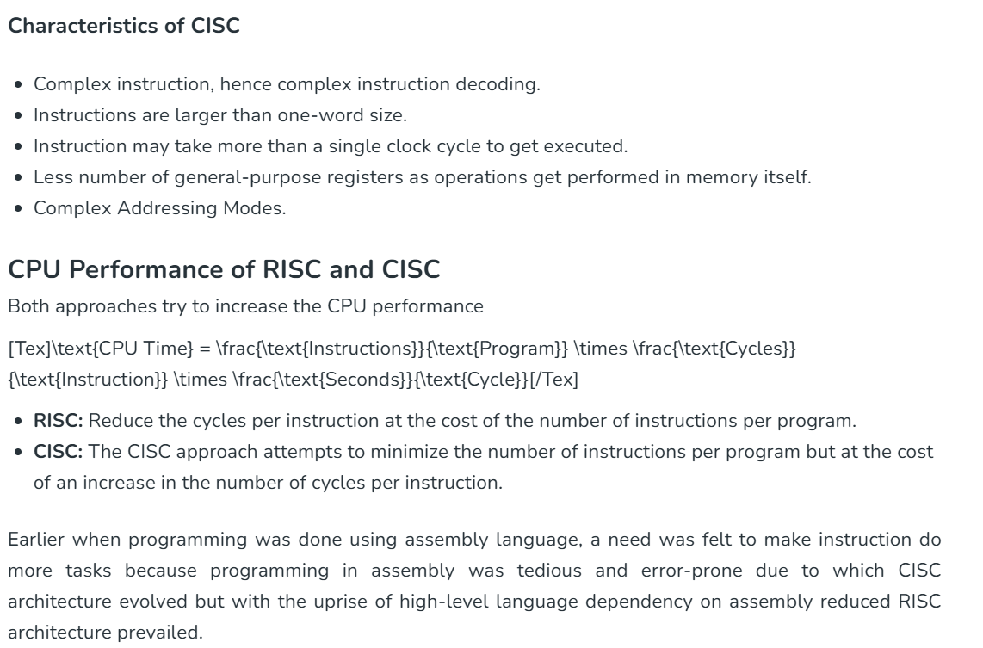

Slide 30
Worked Example: Branching Using Condition Codes
1
The Problem
Code: CMP R1, R2 followed by BEQ TARGET (PC-relative offset = 12). Given: R1 = 7, R2 = 7, current PC (at BEQ) = 3000.
2
Execute CMP
CMP computes R1 - R2 = 7 - 7 = 0 internally (result discarded) and sets flags: Z = 1 (since result is zero).
3
Evaluate Branch Condition
BEQ checks: is Z = 1? Yes, Z = 1, so the branch condition is TRUE and the branch is 'taken'.
4
Compute Target Address
Target Address = PC + Offset = 3000 + 12 = 3012 (using PC-relative addressing).
5
Update PC & Continue
PC is set to 3012. Execution resumes at address 3012 instead of continuing straight-line at 3004.
Presidency University | AIR | CSS2257 | Computer Organization and Architecture
26
Notes:
This example ties together nearly every concept from the entire lecture, so slow down and treat it as the capstone. Begin with CMP, reminding students it behaves exactly like the SUB example from Slide 18 in terms of flag-setting, even though the actual subtraction result itself is thrown away. Then evaluate the branch condition explicitly as a yes/no question, since that is exactly how the hardware treats it: check one bit, Z, and decide. Compute the target address using the PC-relative formula from Slide 15, showing concretely how that abstract addressing mode produces a real jump destination. Finish by contrasting this new PC value, 3012, against what straight-line sequencing would have produced, 3004, making the disruption of normal flow vivid and memorable.

Slide 31
Common Misconceptions & Pitfalls
1
Myth: 'RISC always means fewer total instructions in a program.' Reality: RISC often needs MORE instructions, just simpler ones
!
2
Myth: 'Condition codes are set by every instruction.' Reality: only certain instructions (often arithmetic/compare) update flags
Myth: 'PC always increases.' Reality: branches can move PC backward (loops) or forward
Visual Suggestion
3
Icon: warning/exclamation icon. Image: a 'myth vs reality' two-column badge graphic.
4
Myth: 'Indirect and Indexed addressing are the same.' Reality: indirect uses a pointer lookup; indexed uses base + index arithmetic
Animation: myth text strikes through, then reality text fades in beside it.
Presidency University | AIR | CSS2257 | Computer Organization and Architecture
27
Notes:
Dedicate this slide to catching the exact errors freshers make on exams year after year. For the first myth, clarify that RISC trades instruction count for instruction simplicity, so a RISC program is often longer in line count but each line executes faster, which is a subtlety many students miss. For the second myth, note that not all RISC ISAs auto-set flags on every instruction; some require an explicit compare instruction, so students should never assume flags silently update everywhere. For the third myth, remind them that a branch aimed at an earlier address is exactly how loops work, so PC moving backward is normal and expected, not an error. Encourage students to ask now if any of these distinctions still feel fuzzy.

Slide 32
Quick Check: Test Yourself
1
In MOV R1, 4(R2), which addressing mode is being used?
✎
2
If R1 = 0 after a SUB instruction, which condition flag becomes 1?
Does an unconditional branch check any condition code flags?
Visual Suggestion
3
Icon: pencil/notepad icon. Image: a small 'think-pair-share' graphic of two student silhouettes discussing.
4
True or False: RISC instructions can operate directly on memory operands
Animation: reveal each question one at a time on click.
Presidency University | AIR | CSS2257 | Computer Organization and Architecture
28
Notes:
Run this as a fast, low-pressure formative check before the formal quiz, giving about 2 minutes total. Ask students to jot quick answers individually first, then turn to a neighbor for 30 seconds to compare, a technique called think-pair-share that boosts participation from quieter students. Cold-call one or two pairs for answers, but keep the tone supportive; the goal is surfacing confusion now, not grading. Use their answers as a live diagnostic: if many students miss the base-register question, briefly revisit Slide 14 before moving on, since a strong foundation here directly affects quiz performance in a few minutes.

Slide 33
Summary of Key Points
1
RISC favors many simple, fixed-length instructions; CISC favors fewer, complex, variable-length instructions
✓
2
Addressing modes (immediate, register, direct, indirect, indexed, base-register, PC-relative) determine how operands are located
Condition codes (Z, N, C, V) record the outcome of operations and drive conditional branching
Visual Suggestion
3
Icon: summary/wrap-up ribbon icon. Image: a condensed mind-map connecting all five module topics back to a central 'CPU Execution' node.
4
Straight-line sequencing advances the PC predictably; branching deliberately overrides it
5
Together, these concepts explain exactly how a processor executes a program, instruction by instruction
Animation: five branches converge into the central node.
Presidency University | AIR | CSS2257 | Computer Organization and Architecture
29
Notes:
Use this slide to explicitly close the loop back to the roadmap shown at the very start of the lecture. Go through each bullet briskly, since students have already seen the details, and this is about reinforcing connections rather than teaching anything new. Point out how each concept fed into the next: ISA philosophy shaped addressing modes, addressing modes fed the effective-address examples, condition codes fed conditional branching, and straight-line sequencing set the baseline that branching disrupts. Tell students that everything on this slide is fair game for the upcoming quiz, so this is their cue to mentally flag anything still unclear before we move into active recall.

Slide 34
Quiz Time -- CSS2257
Q1
In ADD R1, #7 -- what addressing mode does #7 represent?
Q2
True or False: In RISC, arithmetic instructions can operate directly on a memory address.
Q3
If a SUB instruction produces a negative result, which flag is set to 1: Z or N?
Q4
What is the Effective Address for LOAD R1, 8(R2) if R2 = 500?
Q5
Does a conditional branch (e.g., BEQ) always jump, regardless of flags? (Yes/No)
Q6
Name the four condition code flags discussed in this lecture.
Presidency University | AIR | CSS2257 | Computer Organization and Architecture
30
Notes:
Explain the quiz format before starting: six short questions, a mix of short-answer and true/false, covering only what was taught today. Give students 4 to 5 minutes to attempt these individually or in pairs on paper or notebooks; be explicit that this is for their own understanding check, not for grading, so they should answer honestly rather than guess to please the instructor. Briefly indicate which module each question maps to if students seem stuck, question 1 relates to addressing modes, questions 2 to 4 blend addressing and condition codes, and questions 5 to 6 cover branching and condition codes respectively. After time is up, move to the next slide to reveal answers together.

Slide 35
Quiz Answers & Explanations
Q1
Immediate addressing -- the value 7 is embedded directly in the instruction, no lookup needed.
Q2
False -- RISC follows Load/Store architecture; only LOAD/STORE instructions touch memory directly.
Q3
N (Negative) is set to 1; Z would only be set if the result were exactly zero.
Q4
Effective Address = 500 + 8 = 508 (Base-register addressing: base + offset).
Q5
No -- a conditional branch jumps only if its specific flag condition is true; otherwise execution continues straight-line.
Q6
Z (Zero), N (Negative), C (Carry), V (Overflow).
Presidency University | AIR | CSS2257 | Computer Organization and Architecture
31
Notes:
Go through each answer one at a time, revealing and briefly re-explaining rather than just reading the answer aloud. For any question with a notably low correct-response rate based on the earlier quick-check or classroom body language, spend an extra 20 to 30 seconds re-deriving the answer instead of rushing past it. Explicitly flag the two most commonly confused pairs again as you go: Z versus N flags, and immediate versus register addressing, since these recur across many exam questions in this subject historically. Close by encouraging students to note down any question they got wrong for focused revision, and remind them this entire lecture's content maps directly onto next week's tutorial problems.

Slide 36
Further Reading & What's Next
1
Textbook: Carl Hamacher, 'Computer Organization and Embedded Systems' -- Chapters on Addressing Modes & RISC
→
2
Explore: ARM Architecture Reference Manual (free online) for a real-world RISC ISA specification
Assignment: Trace PC and condition-code flags for 3 short assembly snippets (to be shared on LMS)
Visual Suggestion
3
Icon: open-book/arrow-forward icon. Image: a simple 'coming next' preview card showing a pipeline diagram teaser.
4
Next Lecture: Pipelining and how RISC's simple instructions enable instruction-level parallelism
Animation: arrow points forward to a blurred preview of the pipeline diagram.
Presidency University | AIR | CSS2257 | Computer Organization and Architecture
32
Notes:
Close the lecture by giving students clear, actionable next steps rather than ending abruptly after the quiz. Point them to the specific textbook chapters covering today's material for reinforcement, and mention the ARM reference manual as an optional but excellent real-world resource for motivated students. Clearly state the assignment expectation and where to find it, reducing post-class confusion. Preview next lecture's topic, pipelining, and tease the connection: explain that RISC's simple, fixed-length, one-cycle instructions are precisely what make pipelining practical, which is exactly why we built this foundation today. Thank students for their engagement and open the floor for any final questions.

